Slide 1
Proportions
Integrated mathematics

Slide 2
What is a Ratio?
A comparison of 2 quantities
Often expressed as a fraction

Slide 3
Example of a Ratio
The ratio of the age of an 34 year old parent to that of a 10 year old child is 34 to 10
Also can be written as:
34:10
$\frac{34}{10}$
3.4

Slide 4
What is a Proportion?
An equation that states that two ratios are equal
Examples:
$$\frac{2}{3}=\frac{6}{9} \frac{x}{24}=\frac{2}{3}$$

Slide 5
Solving Proportions
Example 1
$$\frac{x}{63}=\frac{2}{9}$$

Slide 6
Solving Proportions
Example 2
$$\frac{4}{x}=\frac{10}{20}$$

Slide 7
Solving Proportions
Example 3
$$\frac{−5}{25}=\frac{x}{−15}$$

Slide 8
Solving Proportions
Example 4
$$\frac{x}{13}=\frac{4}{52}$$

Slide 9
Solving Proportions
Example 5
$$\frac{x}{4}=\frac{2}{12}$$

Slide 10
Solving Proportions
Example 6
$$\frac{x+3}{4}=\frac{4}{8}$$

Slide 11
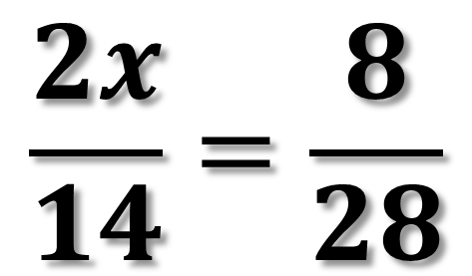
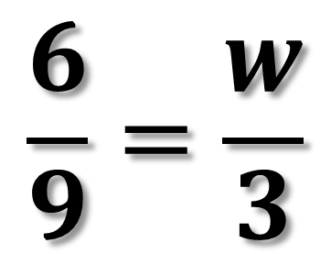
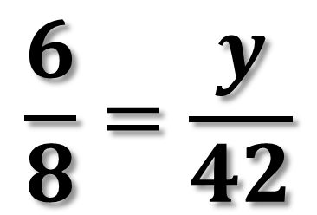
Try These
$$\frac{2x}{14}=\frac{8}{28}$$
$$\frac{6}{8}=\frac{y}{42}$$
$$\frac{6}{9}=\frac{w}{3}$$

Slide 12
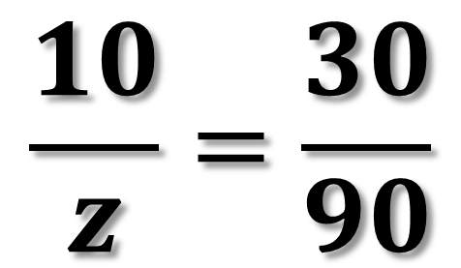
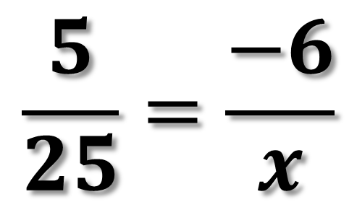
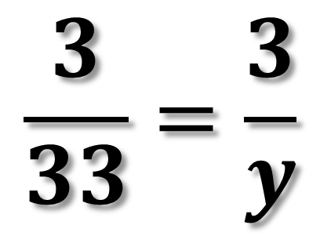
Try These
$$\frac{5}{25}=\frac{−6}{x}$$
$$\frac{10}{z}=\frac{30}{90}$$
$$\frac{3}{33}=\frac{3}{y}$$

