Slide 1
CHAPTER 4
GENETICS
The Science of Heredity

Slide 2
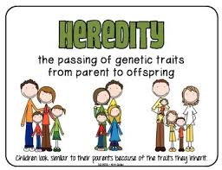

Slide 3
Genetics
Study of how genes (traits) are inherited.

Slide 4
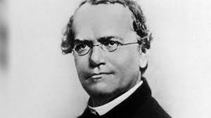
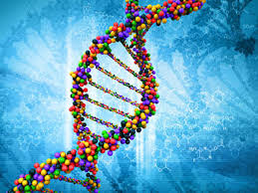
Gregor Mendel
“Father of Genetics”

Slide 5
F = filial generation (daughter/son)

Slide 6
Alleles
Dominant allele- at least one CAPITAL LETTER
Recessive allele- ALL lowercase letters.

Slide 7
AA → Dominant
Aa → Dominant
aa → Recessive

Slide 8
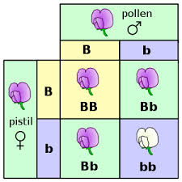
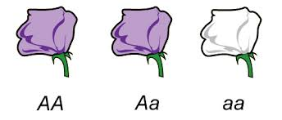

Slide 9
Dominant Allele
The trait always shows up when the allele is present.

Slide 10
Recessive Allele
Hidden when there is a dominant allele.

Slide 11
Terms
Purebred = pure Dominant or pure recessive (TT or tt).
Homozygous Alleles = PUREBRED (TT or tt).

Slide 12
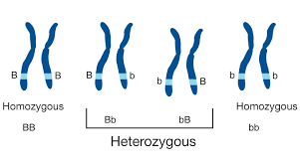
Heterozygous = Hybrid (Tt)

Slide 13
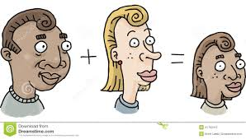
4-2 Probability & Heredity

Slide 14
Probability
The likely an event will occur.
Probability of genetics uses a PUNNET SQUARE.

Slide 15
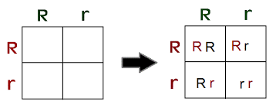
Punnett Square
A diagram that shows all the possible genetic outcomes.

Slide 16
Making a Punnett Square
Draw a box & divide it into 4 squares.
Write the male parent’s alleles top of square & female parent’s alleles on the LEFT side of square.

Slide 18
Rule
Capital Allele MUST be written first!
Rr (Correct) rR (incorrect)

Slide 19
Phenotype vs Genotype
Phenotype = Physical Appearance
Genotype = Genetic Make-up, Alleles (letters)

Slide 20
Phenotypes | Genotypes
Smooth pods | SS
Smooth pods | Ss
Pinched pods | ss
Smooth Pods – Dominant
Pinched Pods- Recessive

Slide 21
BB●
Bb | Bb
Bb | Bb
Bb
○
Genotype 4/4 100% Bb
Phenotype 4/4 100% BLACK

Slide 22
Codominance
An inheritance Pattern where 3 Phenotypes exist. (one is intermediate)
BOTH alleles are expressed in the offspring. Alleles are neither dominant nor recessive.

Slide 23
Ex: Snapdragons
C = Color CR CR = Red, CR CW = Pink
CwCw = White
Offspring will have parts of all 3 colors. No real recessive here.

Slide 24
Cw
CR
CR CR | CR Cw
CR Cw | Cw Cw
CR
Cw

Slide 25
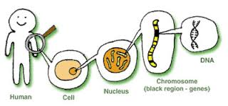
4-3 The Cell & Inheritance

Slide 26
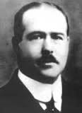
Walter Sutton
In the early 1900s, scientists were working to identify cell structures that carried hereditary factors (genes).
Sutton observed the sex cells in grasshoppers & noticed that each offspring had exactly the same number of chromosomes in body cells as each of the parents.

Slide 27
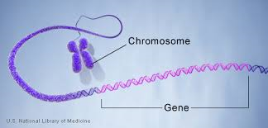
He reasoned that chromosomes occurred in pairs, with one coming from the male & the other from the female parent.

Slide 28
Chromosome Theory of Inheritance
Sutton found that genes are located on chromosomes.
Chromosome Theory- genes are carried from parents to their offspring on chromosomes.

Slide 29
Meiosis
The process by which the number of chromosomes is reduced by half to form sex cells (sperm/eggs).
During meiosis, the chromosome pairs separate & are distributed to 2 different cells. The resulting sex cells have only half as many chromosomes as the other cells in the organism.
When they combine, each sex cell contributes half the number of chromosomes to produce offspring.

Slide 30
Before Meiosis, every parent cell is copied. Centromeres hold the two chromatids together.
Meiosis I- chromosome pairs line up in the center of the cell. The pairs then separate and move to opposite ends of the cell. 2 NEW CELLS form each with half of the number of chromosomes.

Slide 31
Meiosis II- the chromosomes move to the center of the new cell, the centromeres split & chromatids are now separate & move to opposite ends of cell.

Slide 32
Each of the 2 cells separate to create 4 sex cells with each having only half the number of chromosomes.
Each cell has only one chromosome from each original pair.

Slide 33
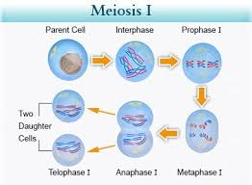

Slide 34
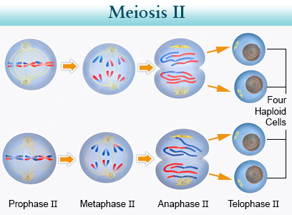

Slide 35
Punnett Squares show the results of meiosis.
Chromosomes are made up of many genes joined together like beads on a string.
Each chromosome pair has the same genes.

Slide 36
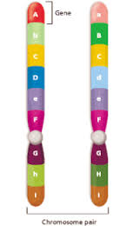
Genes are lined up in the same order on both chromosomes. However, alleles for some of the genes might differ from each other, making the organism HETEROZYGOUS for some traits. IF alleles are the same, the organism is HOMOZYGOUS for those traits.

Slide 38
4-4 The DNA Connection

Slide 39
Chromosomes are made of DNA (deoxyribonucleic Acid)
DNA double stranded.
Each chromosome contains thousands of genes.
The sequence of bases in a gene forms a code.

Slide 40
Every 3 letters is called a CODON.
Code = protein
DNA carries codes.

Slide 41
DNA Bases
PURINES: 1. Adenine (A)
2. Guanine (G)
Pyridimines:
1. Cytosine (C)
2. Thymine (T)

Slide 42
DNA Base Pairing
A = T , G = C,

Slide 43

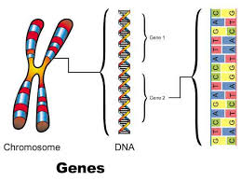
RNA Base Pairing
A = U, G = C.
There is NO “T” in RNA.

Slide 44
Transcription
The process by which RNA is made from DNA.
Occurs in the Nucleus.
Because DNA is too BIG to fit through nuclear pores, messenger RNA is used to “read” DNA.

Slide 45
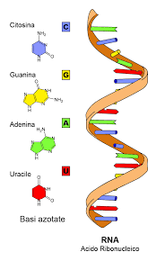
RNA
Single Stranded.
Same bases as DNA EXCEPT instead of T RNA contains U.
After transcription, mRNA leaves the nucleus & attaches onto a ribosome.

Slide 46
The message is translated into an amino acid sequence.
Occurs on ribosomes.
Requires tRNA to translate the code. tRNA can only read 3 mRNA codes at one time (codon).

Slide 47
THE GENETIC CODE
The Codon codes for which amino acid is to be made.
Amino Acids- the building blocks of proteins.

Slide 61
Chapter 4 Genetics

