Slide 1
Replication

Slide 2
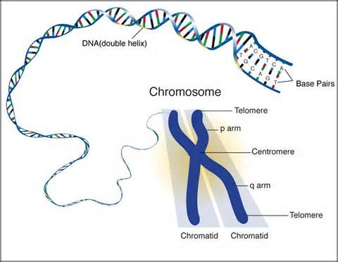
chromosomes
DNA needs to be “packed” for the moving that occurs during cell division
Unpacked form of DNA/protein = chromatin
Packed form of DNA = chromosome

Slide 3
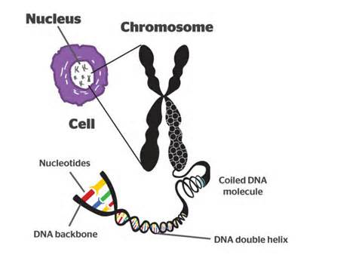
DNA wraps around proteins (histones) – this is called a nucleosome

Slide 4
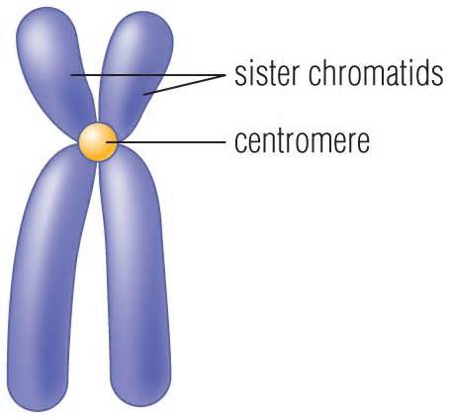
Before cell division, DNA must be copied so each new cell gets a complete copy – replication
Chromosomes consist of the 2 copies, each referred to as sister chromatids

Slide 5
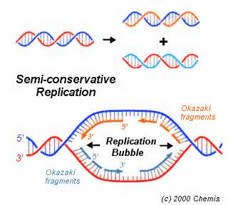
Replication
Each strand of DNA can be used to make the other half by base pairing
Occurs at many places and proceeds in both directions, so is fast

Slide 6
Many enzymes are used for the replication process
Some “unzip” DNA by breaking the hydrogen bonds between the bases
DNA polymerase – joins nucleotides to produce the new strands, and “proofreads”

Slide 7
