Slide 1
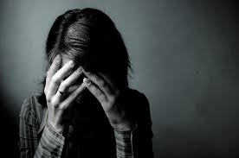
Depression
Grazia De Vita
Psychology, Period 8-9
Mr. McBride

Slide 2
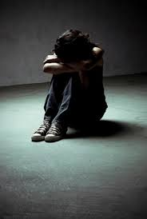
What is Depression?
Severe despondency and dejection typically felt over a period of time and accompanied by feelings of hopelessness and inadequacy
Classified as a mood disorder
          A psychological disorder characterized by the elevation or lowering of a person’s mood
It is an illness, NOT an emotion

Slide 3
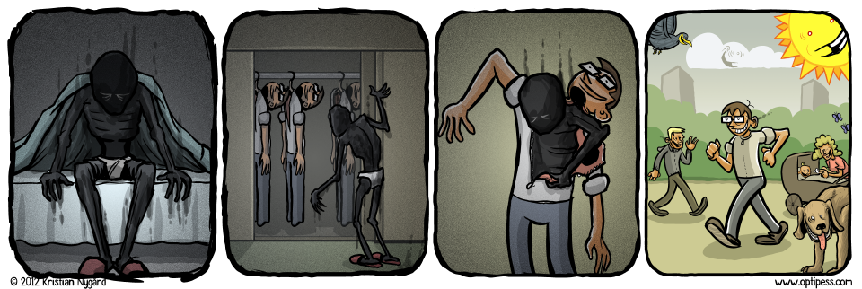
Symptoms
Feelings of hopelessness, worthlessness, or guilt, loss of interest or pleasure, appetite or weight changes, sleeping problems, decreased energy, thinking or focusing problems, unexplainable aches or pains that do not improve with medicine or seem to have a direct cause, suicidal thoughts or plans
Blank faces or stares, lying in bed more than usual, blaming him/herself a lot, talking down on his/herself, frequent crying episodes, increased agitation or restlessness, slowed gait, speaking about life as if it is generally horrible
Not everyone shows symptoms

Slide 4
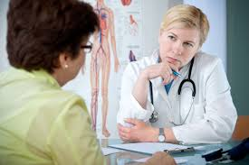
Diagnosis
Underdiagnosed and undertreated due to general practitioners failing to recognize it and the fact that the inertia created by the disorder itself acts as a barrier to take action.
Physical exam by a doctor. Rules out certain viruses, illnesses, or medicines that may cause depression-like symptoms.
Past episodes of depression?
Family history
Laboratory tests not useful
Asking questions is the key

Slide 5
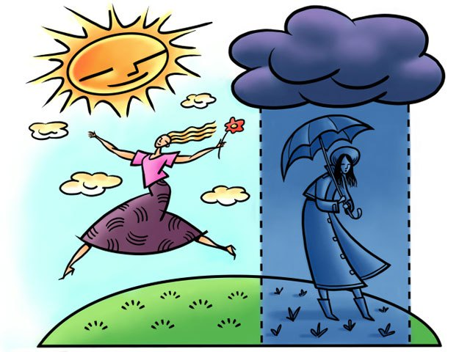
Types of Depression
Major Depression or Clinical Depression – severe symptoms, most common form
Dysthymia – less severe than major depression, but presents similar symptoms
Postpartum Depression – generally occurs within a year of giving birth
Seasonal Affective Disorder (S.A.D.) – involves symptoms of depression most commonly during the winter months but also in the summer.
Psychotic Depression – involves being so depressed that one becomes disconnected from reality.
Bipolar Disorder – also called “manic-depressive disorder,” is characterized by episodes of intense elevation of mood called “mania” and episodes of depression.
Situational Depression – triggered by a stressful or life-changing event, good or bad
Atypical Depression – involves overeating, oversleeping, hypersensitivity, and severe fatigue

Slide 6
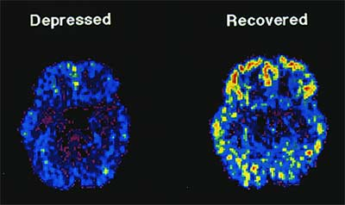
Causes
Abuse.
Certain medications.
Conflict.
Death or a loss.
Genetics.
Major events.
Substance abuse.
Other problems.

Slide 7
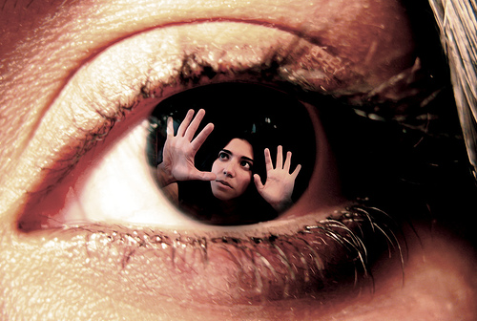
Perspectives
Psychodynamic (focuses on the unconscious) - Says that depression is caused by anger converted into self-hatred, or “anger turned inward.”
Humanistic (focuses on the person as a whole) – says that there really is no direct cause of depression and that the individual as a whole needs treatment. They believe the depressed people themselves have the ability to heal themselves better than anyone else.
Cognitive (focuses on relation of thoughts to behaviors) – says that depressive symptoms result when people attribute the cause of external events as based of maladaptive beliefs and attitudes
Behaviorism (focuses on empirical data obtained through observation and measurement of behavior) – says that depression is caused by a lack of positive reinforcement in the depressed person’s life
Biological (focuses on the science of psychology) – says that depression is directly caused by a chemical imbalance in the brain and believes medicine is the best treatment

Slide 8
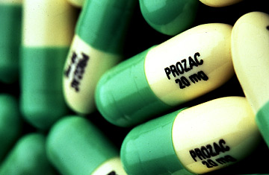
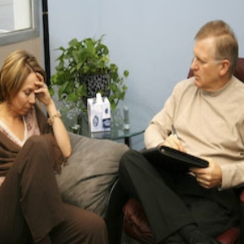
Treatments Therapies
Antidepressants - Biological
Herbal treatment – Humanistic/Biological
Natural treatment – Humanistic/Biological
Self help – Humanistic
Psychotherapy – Psychodynamic
Electroconvulsive Therapy (ECT) - Biological
Cognitive Therapy - Cognitive
Light Therapy – Biological

Slide 9
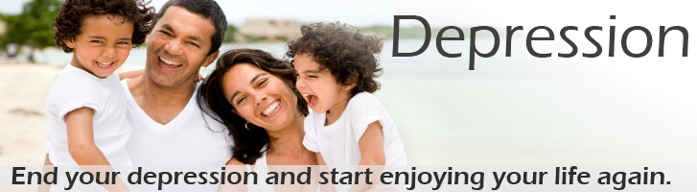
Effectiveness
Very treatable
Medication works, but hardly ever alone. A combination of both medication and therapy, or just therapy itself have proven to be more effective than solely medication.
Psychotherapy is the most effective way to treat depression.
Other treatments have proven to be effective, but not nearly as effective and are much less commonly used.

Slide 10
Culture and Gender
6 million men reported symptoms related to depression. 12 million women did.
This does not say that there are more depressed women than men. It has been proven that is more socially acceptable for women to admit to being depressed than it is for men and so men are more likely to cope by engaging in risky or self-destructive behaviors.
More likely to suffer from MAJOR DEPRESSION:
            45-64 year olds
            women
            blacks
            persons with less than an HS education
            those previously married
            unemployed people
            persons without health insurance coverage

Slide 11

Famous People
Demi Lovato – bipolar disorder
Princess Diana – postpartum depression
Billy Joel – depression, attempted suicide in 1970 at age 21
Angelina Jolie – depression
Abraham Lincoln – depression, suicidal
J.K. Rowling – depression, suicidal
Pete Wentz – depression since age 6
Jim Carrey – depression
Owen Wilson – depression, attempted suicide in 2007 at age 39
Kurt Cobain – depression, committed suicide in 1994 at age 27

Slide 12

Quiz
1.) What kind of disorder is depression classified as?
A.) anxiety disorder
B.) mood disorder
C.) personality disorder
D.) dissociative disorder
2.) Which of the following is a symptom of depression?
A.) getting wrinkles
B.) excessive sweating
C.) appearing pale
D.) suicidal thoughts
3.) Which of the following is the most common form of depression?
A.) major depression
B.) postpartum depression
C.) dysthymia
D.) bipolar disorder
4.) Which of the following can cause depression?
A.) death or loss of a loved one
B.) genetics
C.) substance abuse
D.) all of the above
5.) Which of the following is the most effective way to treat depression?
A.) self-help
B.) antidepressants
C.) light therapy
D.) psychotherapy “talk therapy”

Slide 13
Bibliography
PSYweb complete mental health site. (2010, May). Retrieved from http://psyweb.com/
Depression and mental health disorders | List of Psychological Disorders. (n.d.). Retrieved from http://www.depression-guide.com/disorder-list-alpha.htm
Schimelpfening, N. (2011, September 19). Living With the Stigma of Mental Illness. Retrieved from http://depression.about.com/cs/stigma/a/markofthebeast.htm
National Alliance on Mental Illness (1996). NAMI: National Alliance on Mental Illness - Mental Health Support, Education and Advocacy. Retrieved from http://www.nami.org/

