Slide 1
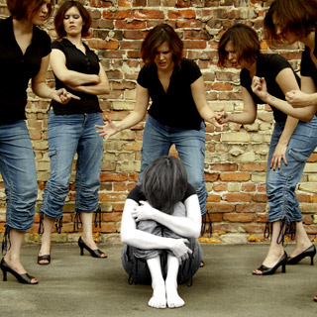
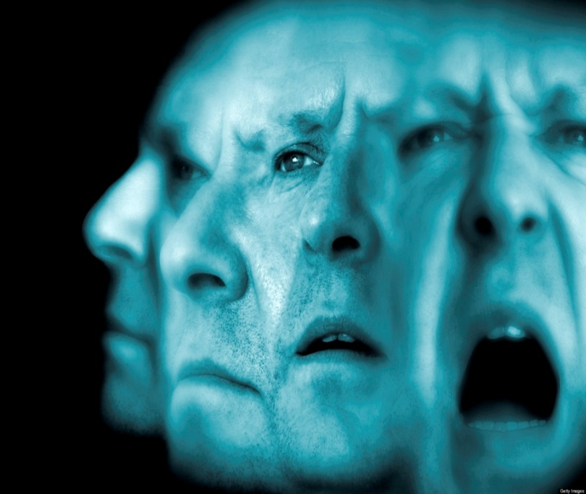
Schizophrenia
Kristi Carr, Jesus Castillo,
Carissa Culp, Chelsea Davidson, Zandrea Deritis

Slide 2
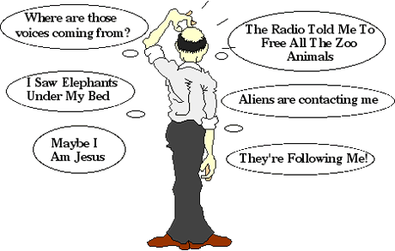
Schizophrenia Categorized
Schizophrenia can be categorized as a psychotic disorder.
A psychotic disorder contains major symptoms of psychosis, or delusions and hallucinations. Delusions are false beliefs that greatly hinder a person's ability to function. When someone is delusional they may think someone is trying to hurt them when no one is or they may believe they are someone else. Hallucinations are false perceptions and can occur within all five senses; such as hearing or seeing things.

Slide 3
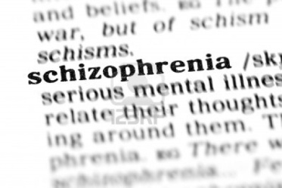
What is Schizophrenia?
Schizophrenia is one of the most devastating forms of mental illness. Historical documents suggest schizophrenia has been a part of mankind for thousands of years.
This disorder was given its name by a Swiss psychiatrist named Eugen Bleuler in the early 1900s. Schizophrenia is Greek for "split mind".
Many people mistakenly believe it refers to someone with multiple personalities.
Schizophrenia usually develops in the early to mid-20s in males, and the late twenties in females. However, it can develop at any stage in life including mid-life, adolescence and even early childhood.
Approximately 1% of the world population has this disorder

Slide 4
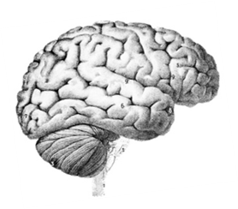
Types of Schizophrenia
Reactive or Acute Schizophrenia
  Reactive schizophrenia is usually sudden and seems to be a reaction to some life crisis. It is often in the early phases when it manifests and is a more treatable form of the illness than process or chronic schizophrenia.
Process Schizophrenia
  Also referred to as poor premorbid schizophrenia, this type is characterized by lengthy periods of its development with a gradual deterioration and has exclusively negative symptoms. It doesn't seem to be related to any major life changing or negative event. This type of schizophrenia is usually associated with "loners" who are rejected by society, who then often tend not to develop social skills and don't excel out of high school.

Slide 5
Negative Symptoms
Symptoms and Indicators
Schizophrenia’s symptoms are broken into to categories: positive symptoms and negative symptoms.
Negative symptoms refer to a significant decrease or complete loss in areas of normal functioning
This includes:
  Significant or complete lack of emotional expressiveness
  Lack of speech: very brief or empty responses
  Inability to begin or perform goal-directed activities

Slide 6
Positive Symptoms
Positive symptoms involve normal functions such as language and perception that are very distorted or exaggerated.
This includes:
  Delusions: firm beliefs not held in reality such as believing aliens have taken one’s organs
  Hallucinations: hearing or seeing things that are not really there
  Disorganized thinking or speech: speaking gibberish or jumping from topic to topic while talking
  Severely disorganized behavior: the inability to perform daily tasks

Slide 7
Diagnosing Schizophrenia
There are currently no medical tests to diagnose schizophrenia
In many cases, a family member or close friend notices the unusual or bizarre symptoms and initiates an evaluation.
Lab tests, drug screening, and/or x-rays are usually done to first rule out other potential causes for the unusual symptoms
To diagnose Schizophrenia, psychiatric assessments are done. This includes interviewing and observing the patient and obtaining additional information from family members, others who know the patient, and/or of past treatment providers and psychiatric records.
However, signs of this disorder must be present for at least six months to be diagnosed. If it’s less than six months it may be diagnosed as schizophreniform disorder or brief psychotic disorder.

Slide 8
Causes & Perspectives of Schizophrenia
Schizophrenia is often associated with dopamine imbalances in the brain and has an underlying genetic cause.
The biological view of schizophrenia is the most researched. It is believed that there is a genetic and biological process at work in the development of schizophrenia. A theory on schizophrenia is the dopamine hypothesis in which it is believed that an overabundance of the neurotransmitter dopamine causes the symptoms of the schizophrenia. Much support has been gathered for this theory through drug trials and research.

Slide 9

From the psychodynamic perspective, schizophrenia is believed to have been caused by cold, un-nurturing, overprotective, and rejecting parents whose contradicting behaviors confuse the children, sending them into a state of primary narcissism, and such regression leads to schizophrenic symptoms when the person tries to regain control of the ego
The cognitive view believes that the misinterpretation of hallucinations produce delusions and withdrawal from society

Slide 10
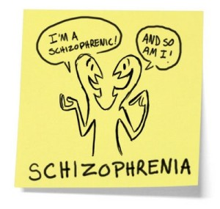
According to learning theorists, children who later have schizophrenia learn irrational reactions and ways of thinking by imitating parents who have their own significant emotional problems. In learning theory, the poor interpersonal relationships of persons with schizophrenia develop because of poor models for learning during childhood.
The sociocultural view assumes that schizophrenia is caused by social labeling and family dysfunction. Social labeling is believed to create a self-fulfilling prediction that once given the person's behavior conforms to. Family dysfunction is believed to cause and worsen schizophrenia through the over-expression of emotion (negative) and the invasion of privacy

Slide 11
Therapies & Perspectives
Psychosocial Treatments
  may include individual, group, or family therapy; vocational training and rehabilitation, education, and support or self-help groups
  help with communication, relationships, motivation, daily activities, managing their illness, and vocational issues
  uses a cognitive perspective
Medication:
  Uses a biological perspective
  Antipsychotic drugs are the most commonly prescribed medications for schizophrenia. For example, Risperdal, Zyprexa, Clozaril, and Abilify.
  reduces or alleviates psychotic symptoms and prevents future psychotic episodes for many people

Slide 12
Cultural and Gender Considerations
Schizophrenia exists between both genders. However, the illness appears earlier in men than in women .
Occurs in many diverse cultures. However, there are differences within this disorder when it comes to developed and developing countries.
  More severe in developed countries
  Delusions are different: tend to reflect the predominant themes and values of a person's culture
  In developed countries it’s a chronic illness, with a gradual rather than sudden onset of symptoms. In developing countries, sudden psychotic reactions of a brief duration are more common.

Slide 13
Famous Schizophrenics
John Nash: Mathematician/Nobel Prize Winner
  In 1957 just after being married Nash was hospitalized at McLean hospital outside of Boston due to months of bizarre behavior
  In January 1961 his wife and mother decided to commit him to Trenton State Hospital in New Jersey where he endured insulin-coma therapy, an aggressive and risky treatment, five days a week for a month and a half.
  met with a psychiatrist, who prescribed anti-psychotic medication. Nash's condition improved
  John went off his medication, fearing the effects of the drugs on his thinking, and the delusional symptoms resurfaced.
  In the 1980s, Nash slowly began to get better -- his delusions diminished and he became more engaged with the world around him
  He is still alive today

Slide 14
Eduard Einstein: Son of Famous physicist Albert Einstein
  In 1930, at the age of twenty years, Eduard developed schizophrenia
  In 1932 he moved for the first time to the "Burghoelzli", a psychiatric sanatorium in Zurich but left in 1933
  However, went back in 1948 where he continuously lived and died in 1965
Tom Harrell: Famous Jazz Musician
  When he went off to college at 18, his sister received a call that he had tried to commit suicide. This was the first sign there was problems
  Dr. Eric Marcus, a New York psychiatrist and psychoanalyst didn’t know what was causing this illness
  When Harrell was in his 20s, there was an incident where voices ordered him to walk through a window after he had some orange juice.
  Although he struggles everyday Tom still plays and is living today

Slide 15
Vincent Van Gogh: Artist
  Vincent van Gogh had an eccentric personality and unstable moods, suffered from recurrent psychotic episodes during the last 2 years of his life, and committed suicide at the age of 37
  Although there was limited evidence, well over 150 physicians have ventured a perplexing variety of diagnoses of his illness
Amanda Bynes: Actress
  Recently diagnosed with this disorder along with bipolar disorder at age 23
  Treated at the UCLA Medical Center but was later moved to a rehabilitative center in Malibu, California

Slide 16
Quiz
What percent of the world population has Schizophrenia?
    A. 5% B. 1%
    C. 10% D. 25%
2. Who is not a famous person with Schizophrenia?
A. John Nash B. Eduard Einstein
C. Abraham Lincoln D. Tom Harrell
3.What is Schizophrenia categorized as?
    A. Anxiety Disorder B. Sleep Disorder
    C. Psychotic Disorder D. Personality Disorder
4.What is Schizophrenia often mistaken as?
  A. Multiple Personalities B. Psychotic Break
  C. A Self-esteem Issue D. A Fake Disorder
5.Which is not a positive symptoms of Schizophrenia?
  A. Delusions B. Hallucinations
  C. Anger D. Disorganized Speech

Slide 17
Works Cited
Schizophrenia Overview. (n.d.). Schizophrenia Overview. Retrieved January 22, 2014, from http://www.psyweb.com/Mdisord/jsp/schid.jsp
Schizophrenia Symptom, Treatment and cause. (n.d.). How to get rid of Schizophrenia?. Retrieved January 22, 2014, from http://www.depression-guide.com/schizophrenia.htm
Schizophrenia in Psychotic Disorders at ALLPSYCH Online. (n.d.). Schizophrenia in Psychotic Disorders at ALLPSYCH Online. Retrieved January 22, 2014, from http://www.allpsych.com/disorders/psychotic/schizophrenia.html

Slide 18
Works Cited
Schizophrenia: Symptoms, Diagnosis, Treatment, and Views About Schizophrenia. (n.d.). Examiner.com. Retrieved January 22, 2014, from http://www.examiner.com/article/schizophrenia-symptoms-diagnosis-treatment-and-views-about-schizophrenia
Secret Life of the Brain. (n.d.). Culture and Schizophrenia. Retrieved January 22, 2014, from http://www.pbs.org/wnet/brain/episodes/cultures

