Slide 1
Ceramics
pots and other articles made from clay and then hardened by heat.

Slide 2
Clay Where does it come from? How is it made? How many types are there? What are its uses?

Slide 3
Where does it come from?
Clay is a NATURAL RESOURCE, not made by humans, instead comes from the Earth!
Clay is in fact all around us, it is part of
the earth’s crust and the surface on which we tread.
Usually found in little pockets that appear a couple of feet below the ground.

Slide 4
How is it made?
Clay is formed from
GRANITE ROCK broken down into small pieces over time.
What causes this?
Over millions of years of weathering, (through coming into contact with SUNLIGHT, RAIN and ICE).

Slide 5
How many types of Clay?
2 types of clay!
PRIMARY CLAY – clay that remained in the same place for millions of years.
White in color
Not easily molded!

Slide 6
Secondary Clay
clay we will be using.
Not found in the same place over millions of years.
Carried by water picking up minerals changing the colors: Red, yellow, black and GREY!!
Easily molded & formed.

Slide 7
What are the uses of Clay?
CLAY is a NATURAL RESOURCE.
It has been used by humans for longer and for more reasons than any other material.
9,000 years humans used clay to make bricks.
ornaments, plates, cups, tea pots, washbasins, insulation for electrical cables and power-lines, and even the tiles on the space shuttle.

Slide 8
Video on how its made!!
https://www.youtube.com/watch?feature=player_detailpage&v=FXD9zDs9ygU

Slide 9
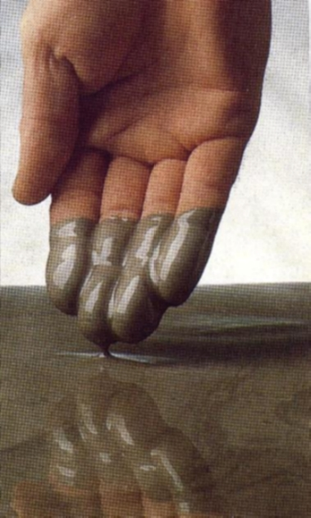
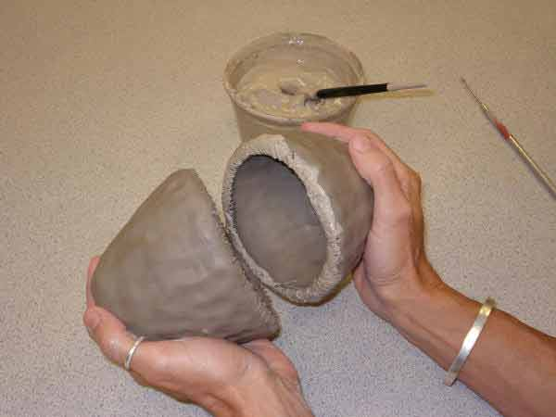
Score & Slip
Score- Making grooves into the clay surface before adding slip . Enables the two pieces to connect better.
Slip – watered down clay.

Slide 10
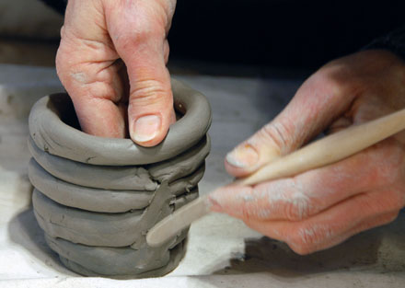
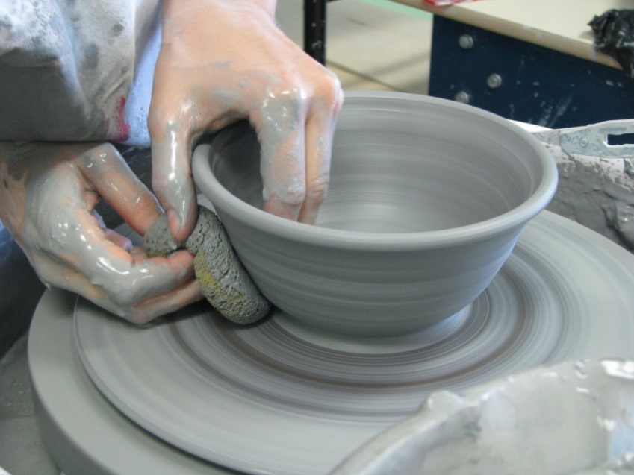
Plastic Stage
Stages of Clay
Stage 1-
Plastic - stage of clay that most of the work is done, like throwing it on the wheel. Plastic clay is soft and easily workable.

Slide 11
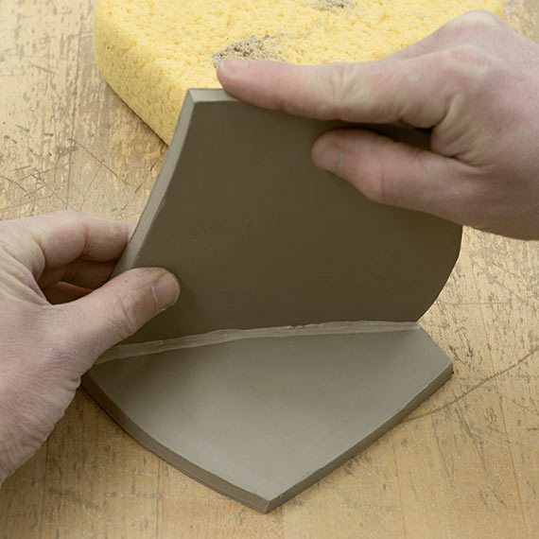
Leather Hard Clay
Stage 2
Leather Hard - stage of clay that a pot is in when it's half-way dry.
Can be helpful when
constructing slab
boxes.

Slide 12
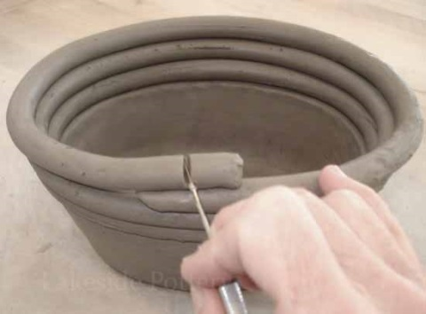
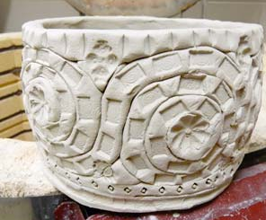
Bone Dry Greenware
Bone Dry!!!
Not bone dry!!
Stage 3
Bone Dry (or Green) - when the pot has been exposed to air and all of the water has evaporated.
Very fragile at this point!!
This is the stage in which it is put, very carefully, into the bisque kiln.

Slide 13
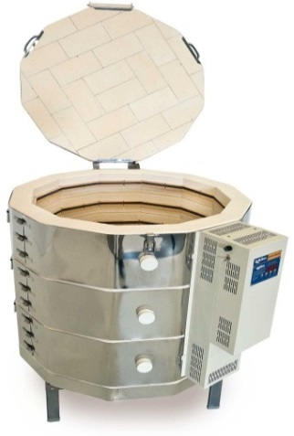
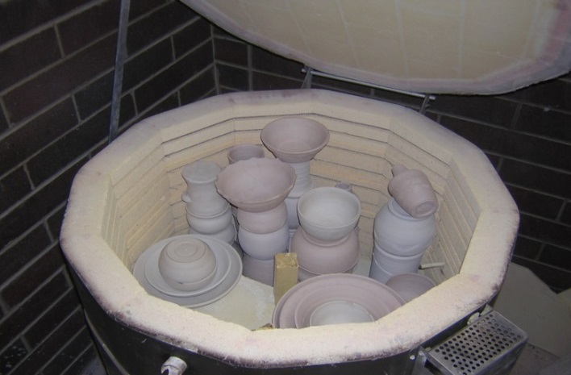
Bisque
Stage 4
Bisque - clay that has been fired in a kiln
No additions can be added to the pot, and it is almost complete. Glaze can now be added.
Kiln:
A special furnace (oven) that reaches extreme temperatures in order to bake the clay.
Kilns can be electric(the schools), gas or wood fired.

Slide 14
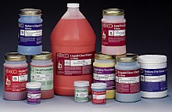
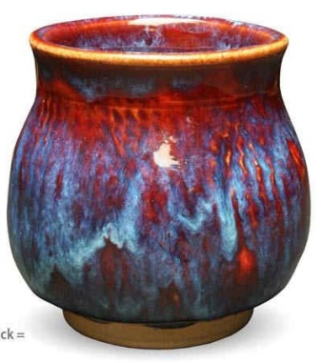
GlazeWare
Stage 5 Glazeware
Fired-
heated in the kiln
After your pottery has been Bisqued, it needs to be fired again. Ceramics are fired 2 times in all.
Glazing:
A coating of glass which is fussed to the surface of the clay. Is painted on and can look dry and not seem like the correct color, but will change after it is fired in the kiln.

Slide 15
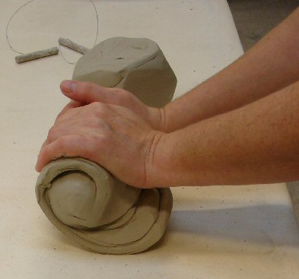
Working with clay!
Wedging:
process of kneading clay like bread, to remove the unwanted air bubbles.
Air bubbles can explode inside the kiln and destroy the ceramic.

Slide 16
Pinch Pot
making pottery in which a ball of clay is shaped, then your fingers are used to pinch the ball into a bowl.

Slide 17
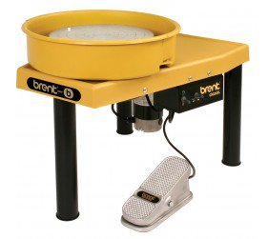
Hand building or The Wheel?
Hand built:
the process of building clay pieces without
using a throwingwheel and only using your
hands and tools.
Throwing on the Wheel:
creating ceramics on a moving circle controlled
by a pedal. Cups, bowls, etc. can be made
using this method due to the symmetry of
them.

Slide 18
Slip & Score! Attaching pieces!
1st: Score:
Using a fork or a sharp tool scratch the
surface of the moist workable clay to make a rough surface.
2nd: Slip:
Then place slip onto the rough made surface to act like glue before connecting the new piece of clay.

Slide 19
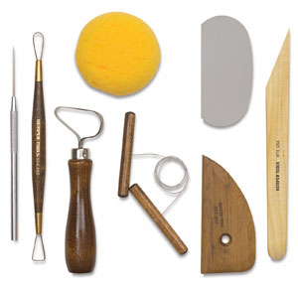
Modeling tools Different shaped tools to sculpt the clay. :
Ribbon tool:
a tool that has a metal loop on top to scoop out clay.
Clay needle:
Pointed sharp tool for craving
into clay.
Sponges!
Wire clay cutters:
A wire with two handles to cut
through clay easily.

