Slide 1
Family
Karen Malt, MSN, RN

Slide 2
Family Defined
Two or more person’s living and interacting together. Traditionally, the nuclear family, or biological family has been the basic unit or structure of the American family.
Variations of the Family Structure
Review Table 15-1 (Handout) or See Introduction to Maternity & Pediatric Nursing

Slide 3
Nuclear Family
Consists of a mother, father, and children.
Has two generations of family members living together.
Sometimes known as the “cereal packet” family.

Slide 4
Single Parent/Adult Family
One adult, either mother, or father, or some other adult in authority position of the family.

Slide 5
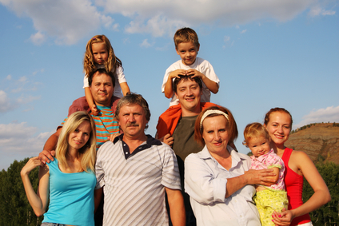
Bi-Nuclear Family
The extended family, usually consisting of two separate households, formed by the children and subsequent spouses of the partners in a divorce.

Slide 6
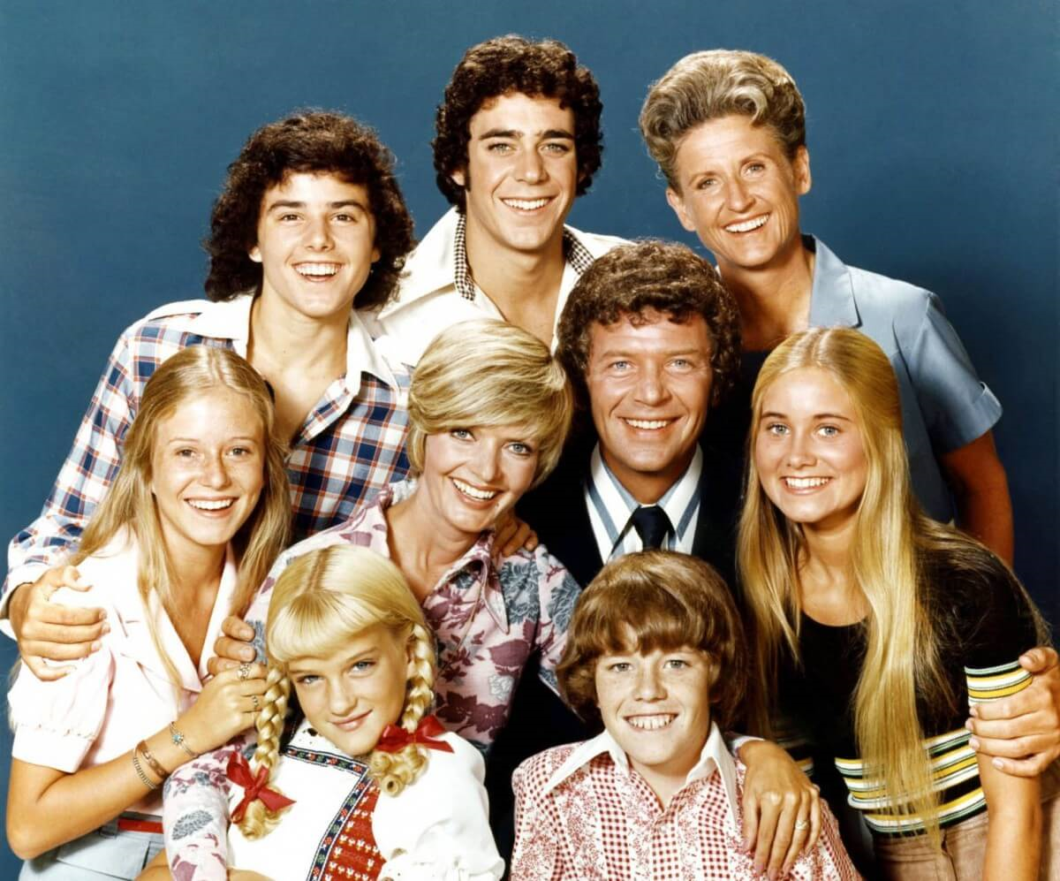
Blended or Reconstituted Family
A blended family is one where the parents have children from previous relationships but all the members come together as one unit.

Slide 7
Alternative Family
Communal – groups of people living together.
Foster – a family that takes in a child for what is usually a short time to provide care that the parents are unable to provide.
Homosexual/Lesbian – two men or two women as head of household.
Unmarried Couple/Cohabitation – a man and a woman as head of the family who are unmarried in the eyes of the law.

Slide 8
Stages of the Family Life Cycle of a Two-Parent Nuclear Family (See page 84 Med/Surgical)
1). Beginning Families (Stage of Marriage)
2). Families with Young Children
3). Families with Adolescents
4). Launching children and moving on
5). Families in Later Life

Slide 9
Family Roles and Communication
A “Role” is what is expected of the individual assigned to a particular position or the way a person is expected to behave.
Culture and social class have an influence on family roles.
Family Roles can be performance oriented such as “breadwinner” or homemaker, or roles may be emotional such as “nurturer.”
Members may fill more than one role and/or roles may be shifted.

Slide 10
Family Roles and Communication
Roles in the Family can be Formal or Informal
Formal Roles include wife/mother, husband/father, son/daughter, sister/brother. Each Formal Role has expectations for that role; wage-earner, homemaker, financial manager, cook, etc. Smaller families or Single-Parent Family members may need to assume more functions within the family.
Informal Roles not as often as apparent and usually meet the emotional needs of individuals. Informal roles have different requirements that are based on personality attributes of individual members. Some informal roles include encourager, martyr, scapegoat, nurturer, family-go-between

Slide 11
Family; Meeting the Needs of Each Member
Spouse or Adult Members; the family helps to stabilize their lives by meeting their affection needs and social needs.
Children; The Family provides physical and emotional support, directs personality development, and is the main learning context for behaviors, thoughts and feelings.
The Family provides emotional support and security to its members through love, acceptance, concern, and nurturing.

Slide 12
Factors Affecting the Family
Loss of a Family Member (Parent, sibling)
Financial Factors
Divorce
Physical or Mental Health issues affecting family members
Chemical Abuse issues

Slide 13
Family Interaction
A unique form of social interaction among members of the family.
One of the MOST important influences on family interaction is self-esteem of each member.
Adult members who have adequate self-esteem are able to provide the love and nurturing that children need to develop self-esteem, belonging and acceptance.
Adults that lack self-acceptance and self-respect are unlikely to be loving spouses or parents. In a healthy family members love and respect one another.

Slide 14
Family Communication Patterns
Clear communication helps to provide a nurturing environment in which family members function well.
Poor communication among family members can be a major issue for families.
Communication in the family can be “functional” or “dysfunctional.”

Slide 15
Family Communication Patterns
Functional Communication
Clear transmission of a message that enables the receiver to understand the intent of what the sender transmits.
Represents acceptance of individual differences, openness, honesty, acknowledgement of feelings, recognition of the needs of members.
Verbal messages of caring, and non-verbal physical gestures such as touch, holding, looking.

Slide 16
Family Communication Patterns
Dysfunctional Communication
Unclear transmission of a message
Primary reason for dysfunctional communication is low self-esteem among family members.
Communication becomes confusing, vague, indirect, secretive, and defensive because the individuals lack the ability to appreciate differences , thoughts and feelings of other family members and are unable to deal with conflict.
The intent of the communication is not clear. For example, a family member may continually restate their own issues without listening to others. Another example, is the inability to focus on an issue and instead rambles from one issue to another without resolution of the original problem.

Slide 17
Family and Culture
In the United States, many variations in cultural patterns among families are found.
The best way to determine specific cultural patterns of a family is to get the information from the family itself.
The nurse needs to determine the family’s values, beliefs, customs, and behaviors that influence health needs, health care practices, and family attitudes toward health and illness, health care providers, and health care systems

Slide 18
Family/Cultural Considerations
Some cultures are more open to communicate than others.
Some individuals express their feelings more openly than others.

Slide 19
Cultural Beliefs Related to Health and Illness
Example; Some believe illness is a form of divine punishment for a sin that one has committed.
Another belief involves a person’s ability to balance physical health with nature.
The ‘Hot” and “Cold” Theory involves health and illness being influenced by four humors that regulate body function. An imbalance between these fluids causes illness.
The four humors are;
Phlegm
Blood
Black Bile
Yellow Bile

Slide 20
Cultural Beliefs Related to Health and Illness
Many Ethnic groups use healers who practice health care outside of the traditional health care arena.
Generally, non-Western societies believe that illness has supernatural causes and these persons have a more holistic approach to illness.
Healers use a variety of potions and plants in their practice.

Slide 21
Cultural Beliefs Related to Health
Considering your own race or ethnicity, identify three cultural beliefs related to health that are held by your family. For example, how are you expected to respond to illness or stress? When do you seek medical care and what kind of provider do you see? Do you use any complementary or alternative therapies? What activities are believed to promote health or prevent disease?

Slide 22
Family Coping
Family coping refers to a positive response that families employ to resolve problems or reduce stress.
Family coping processes and strategies are important in order for the family to maintain necessary functions.

Slide 23
Stress and Adaptation
Stress is the response produced by a stress (an event which causes the stress).
Adaptation is the process of adjusting to change.
How a family adapts to stress and change affects family function.
If the family adapts to stress negatively than the family functions less effectively.

Slide 24
Family Crisis
Occurs when the stressors are overwhelming and the family is unable to cope and resolve the problems.
The Nurse may be in a situation to determine whether the family’s problem is being adequately managed by family members, whether a crisis state exists, or whether the current problem is part of a chronic inability to solve problems.

Slide 25
Strategies for Adapting to Stress
Defense Mechanisms – Avoidance behaviors, usually negative responses (for list of see page 49, Chapter 4 Med/Surgical Text)
Coping Strategies – behaviors used for effective problem solving, considered positive. (Journaling, warm bath, listening to music, meditation, etc.)
Mastery – end result of using effective coping strategies. Problems are solved competently and the family functions in a health manner.

Slide 26
Family Nursing Care
The Nurse should;
Determine what stressors are being experienced by the family.
What kind of coping strategies are used.
How well the family is coping with the stress.
Encourage all family members to be involved in the process.
Assist families in learning coping strategies.
Refer family members to outside resources if necessary.

Slide 27
Role of the Nurse
Family members often provide support for family members during an illness.
Family members may need support.
Families often need information and reassurance.
Families can add to the patient’s burdens, or provide considerable support.
The care plan should also consider the family’s influence on individual members.
With patient permission, include family members in on decision making regarding patient care.

Slide 28
Barriers to Competent Care
Cost
No insurance or supplemental insurance
Transportation
Availability of Care (geographic location)
Cultural, ethnic, religious barriers

Slide 29
Religious Beliefs Affecting Health Care (page 69 Medical Surgical Text)
Judaism –
A woman is considered to be in an impure state anytime blood is coming from her uterus. During this time the husband will not have contact with his wife. The nurse must be aware of this because the husband will not even assist his wife in bed.
Kosher dietary laws; no mixing of milk and meat at a meal.
Sabbath; Observed from sunset Friday until sunset Saturday. Prohibits riding in a car, smoking, turning lights on and off, handling money, using the telephone, watching television.
Orthodox Jewish men wear skull caps at all times.

Slide 30
Religious Beliefs Affecting Health Care (page 69 Medical Surgical Text)
Christianity –
Anointing of the Sick – A priest anoints the forehead and hands of the sick.
Abstain from eating meat on Ash Wednesday and all Fridays during Lent. Some older Catholics may still refrain from meat on all Fridays.
A Bible is used to study The Word of God.
Rosary beads are used during the “Rosary Prayer.”

Slide 31
Religious Beliefs Affecting Health Care (page 69 Medical Surgical Text)
Islam –
No pork products or alcohol. Only “Halal” meat is permissible to eat, which is meat that has been blessed and slaughtered in a specific way.
At prayer time, washing is required, even by those who are ill.
The Koran should not be touched by anyone considered ritually unclean. Nothing should be placed on top of the Koran.
Muslim women prefer female physicians. Muslim women are not allowed to sign a consent, so husbands must be present.

Slide 32
Religious Beliefs Affecting Health Care (page 69 Medical Surgical Text)
Hinduism –
Believe illness as a misuse of the body or a consequence of sins committed in a previous life.
Believe union with Brahman (God) achieved through prayer, ritual, purity, self-control, truth, non-violence, charity, compassion toward other creatures.
Reincarnation, after death will be reborn.
Offer daily worship in a shrine in the home

Slide 33
Resources/ Sources for Sick Family Members
Social Workers
Home Care Services
Bereavement Services
Chaplaincy (Spiritual Services)
Language Services
Transportation Services
Financial Services

