Slide 1
Early Battles of WWI

Slide 2
PDN
Enduring Understanding:
The assassination of Archduke Franz Ferdinand was the single event credited with starting the war
Essential Questions:
How did Germany’s invasion of Belgium bring Britain into the war?
How did a single event start a chain reaction that sparked World War I?

Slide 3
Objectives
Identify the key event that sparked World War I
Identify early battles of the war and describe the impact of the fighting
Explain how WWI was a global conflict

Slide 4
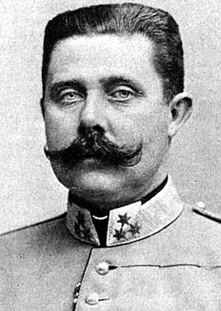
The Powder Keg Explodes
Archduke Franz Ferdinand is Assassinated on June 28, 1914 by a Serbian Nationalist
Austria-Hungary declares war on Serbia after it does not agree to all terms of ultimatum
Germany signed treaty with Britain and France guaranteeing Belgian neutrality
Germany marches through Belgium to reach France as part of the Schlieffen Plan – Aug. 1914

Slide 5
Major Players (Must know for the test!)
Central Powers (Bad Guys):
Austria-Hungary, Germany, & Ottoman Empire
Allies:
Russia, France, Great Britain, & Italy
Eventually United States joined this side later

Slide 6
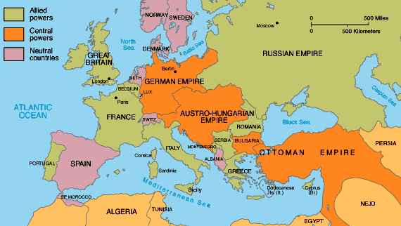

Slide 7
AUGUST 1914
Battle of the Frontiers
Germany vs. France & Great Britain
heavy losses on both sides
Germany won

Slide 8
AUGUST 1914
Battle of Tannenberg
Russia vs. Germany
caused distraction & helped allied troops collect in west
Germany won

Slide 9
SEPTEMBER 1914
Battle of the Marne
Allies vs. Germany
Allies won → pushed Germany back
In northern France:
Germany built series of trenches as they retreated
Allies built their own trenches
this area became deadlocked (no one advanced)
known as the Western Front (west of Germany)

Slide 10
