Slide 1
See what you know…

Slide 2
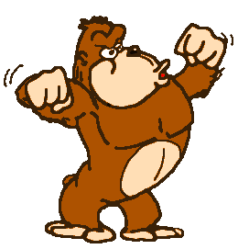
Humans are hominids, a family of primates. How old do you think the earliest hominid fossil is?
50,000 -100,000 years old
1 – 2 million years old
2-4 million years old
6-7 million years old

Slide 3
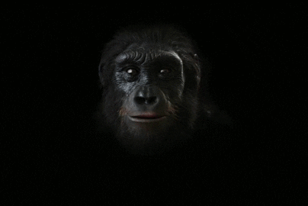
The human SPECIES is called homo sapiens, how old do you think the oldest fossil of a human is?
10-20 thousand years old
50-100 thousand years old
200-300 thousand years old
1-2 million years old.

Slide 4
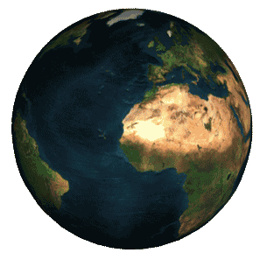
APPROXIMATELY How long have humans (H. Sapiens) been on the planet ?
.007% of the time
1% of the time
30 % of the time
50% of the time

Slide 5
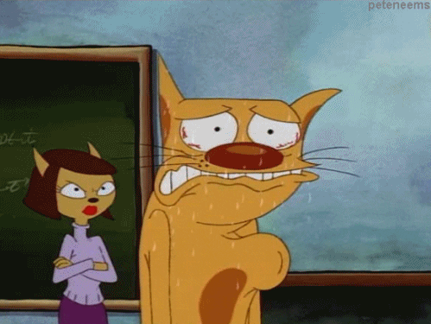
In humans, cells build tissues and tissues build organs. The heart is a major organ of the circulatory system. About how many times does it beat in one’s lifetime (assuming they live to be about 78 – the average life expectancy in Pa) ?
Over 10,000 times
Over 100,000 times
Over 1 million times
Over 3 million times
When DeBlass is looking around the room to pick someone to answer.

Slide 6
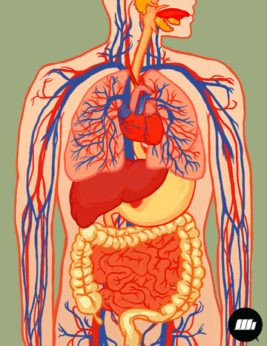
Organs working together make up organ systems in living things, about how many organ systems do you think humans have?
21
11
9
4

Slide 7
UNIT 6
Intro to human origin and makeup

Slide 8
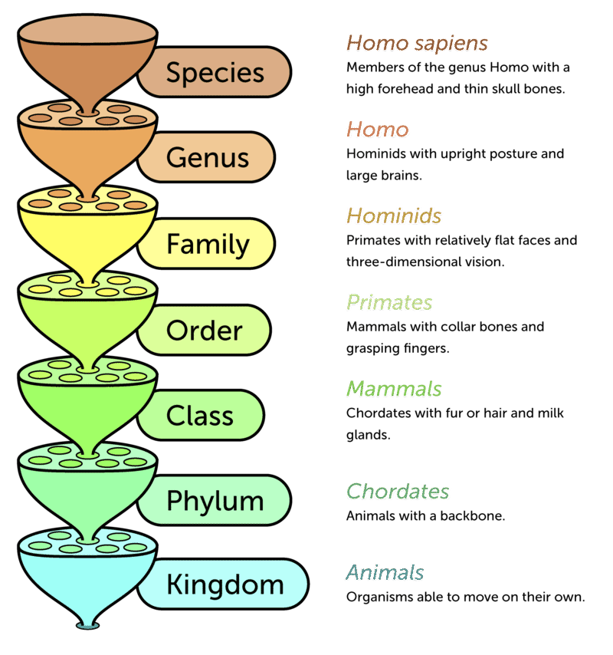

Slide 9
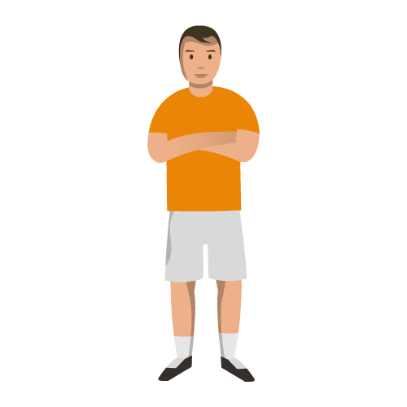
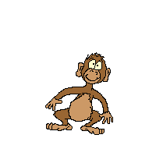
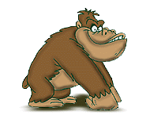
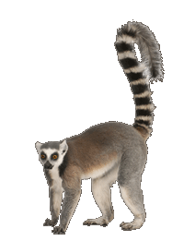
Human origins
Humans belong to a class called primates
This includes lemurs, monkeys, apes as well.

Slide 10
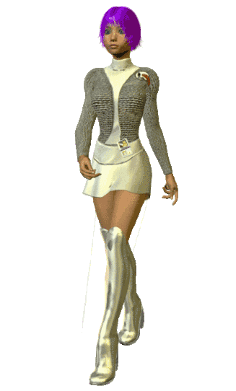
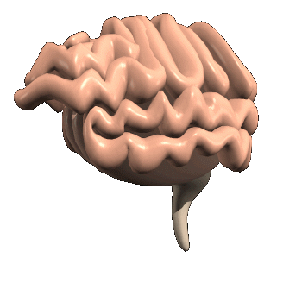
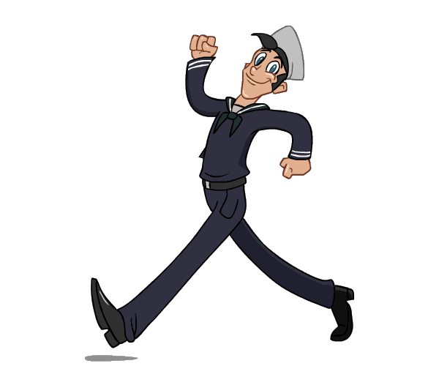
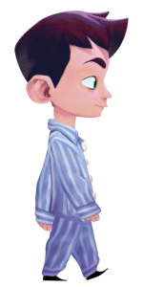
Human origins
Humans are also HOMINIDS - a family of organisms that:
Are bipedal: walk upright
Have an enlarged brain vs. body size

Slide 11
Human Origins
How we got here
The theory with most support suggests that the species H. Sapiens arose from other Homo species that stayed in Africa.
Others that left, all became extinct, like Neanderthals.

Slide 12
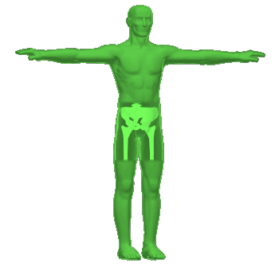
Section 2: How we are built

Slide 13
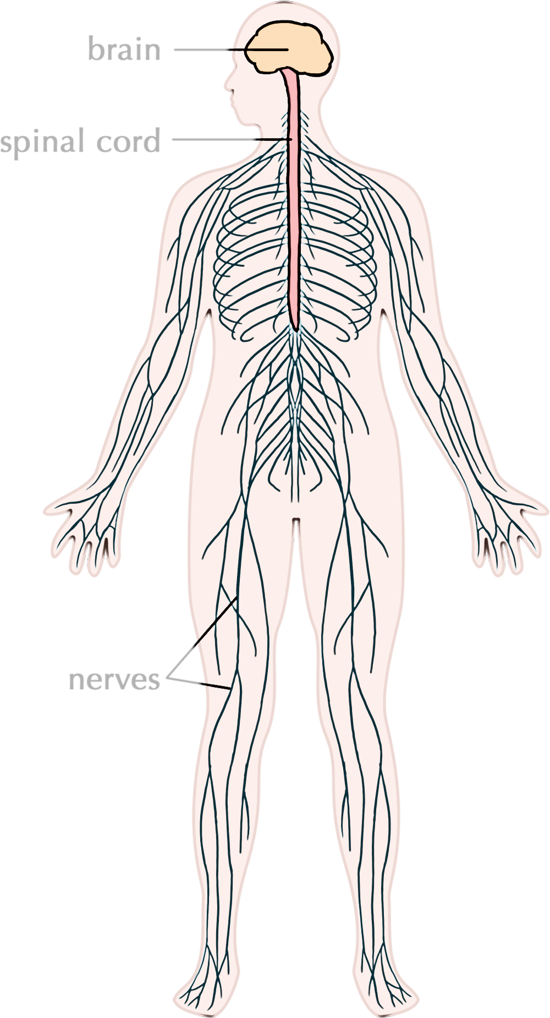
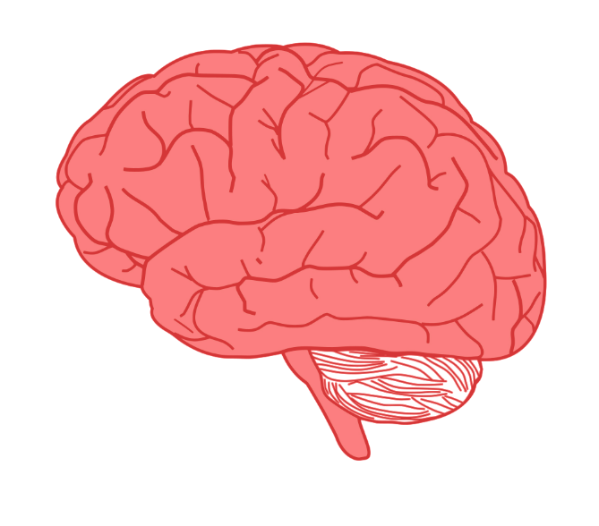
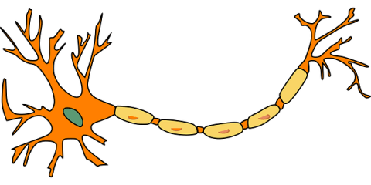
How are we built?
Cells: the smallest unit of life, humans have many different types of cells with different shapes and functions. Ex. Nerve cell
Tissues: groups of similar cells that need to perform a function. Ex. Nervous tissue
Organ: groups of similar tissues that perform the same function. Ex. Brain
Organ system: groups of organs that perform a function

Slide 14
Tissue Types
Epithelial
Connective
Nervous
Muscular
Sheets of cells that cover the body and organs
Groups of cells that hold together and support other tissue
Transmits signals in the body
Used for movement

Slide 15
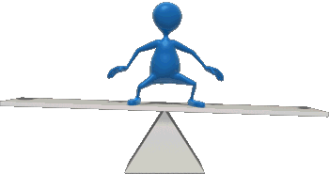
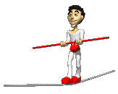
Organ systems - homeostasis
Homeostasis – the ability to maintain a steady internal environment, internal conditions.

Slide 16
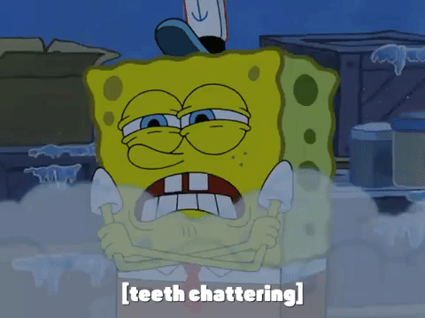
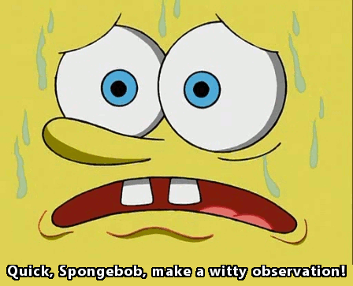
Feedback
Negative feedback loop – system reacts to STOP or SLOW what is happening; reverse it.
v
v
v

Slide 17
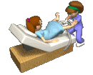
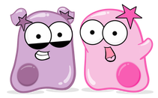
Feedback
Positive feedback loop – system reacts to INCREASE what is happening;
Chemicals increase the number of contractions until a child is born

Slide 18
Organ systems – page 589
Organ system | Important organs/parts | How it maintains HOMEOSTASIS
Integumentary | Skin, hair, nails | Hair and sweat glands maintain body temperature, moisture
Circulatory | Heart, veins, arteries, capillaries | Maintain oxygen/CO2 movement throughout body
Respiratory | Trachea, Lungs - alveoli | Maintain movement of oxygen/CO2 into/out of the body
Excretory | Kidneys, bladder | Maintain the level of water, chemicals in the blood

Slide 19
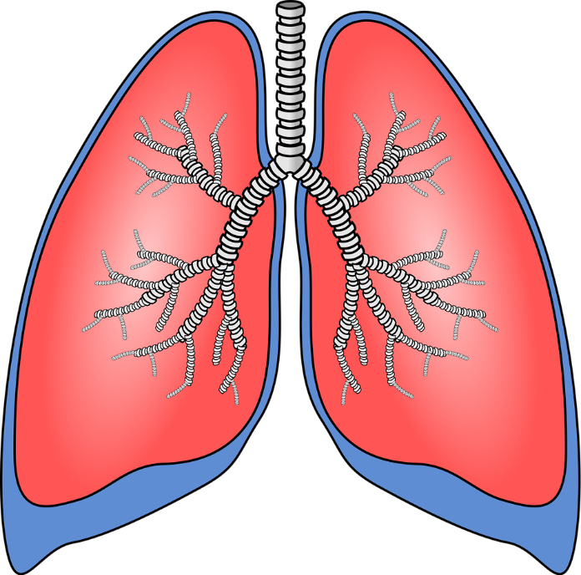
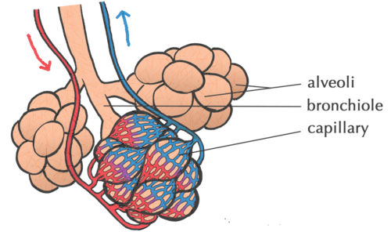
Capillaries and Alveoli
Alveoli/ capillaries increase surface area

Slide 20
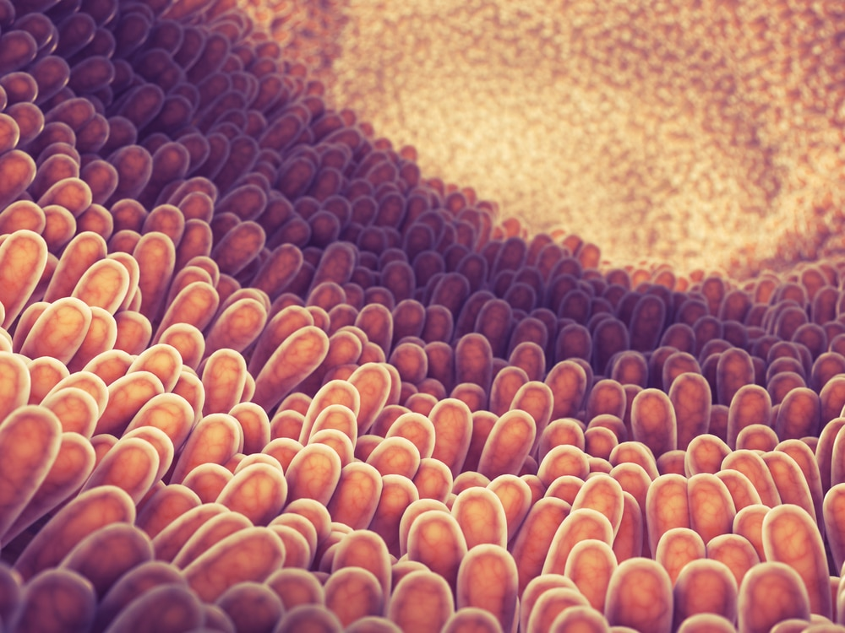
Surface area – the amount of space on the outermost layer of something
The villi of the lining of the stomach

Slide 21
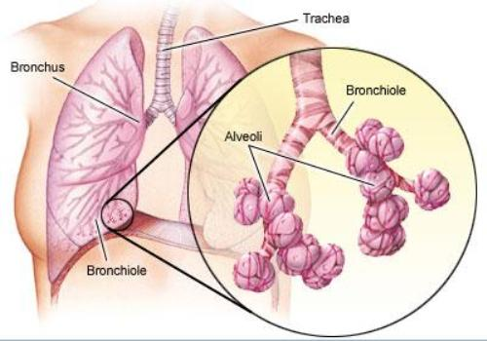
Alveoli

Slide 22
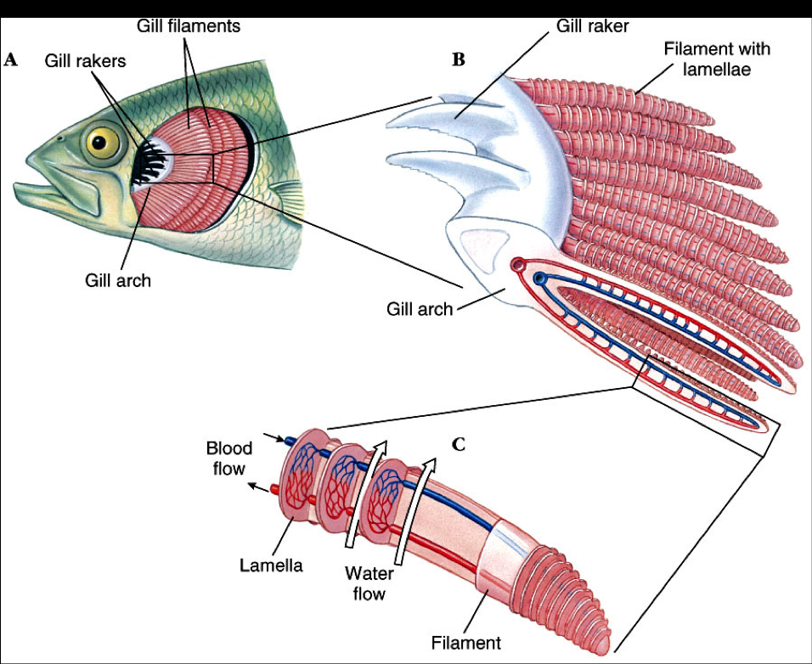
Gills of fish

Slide 23
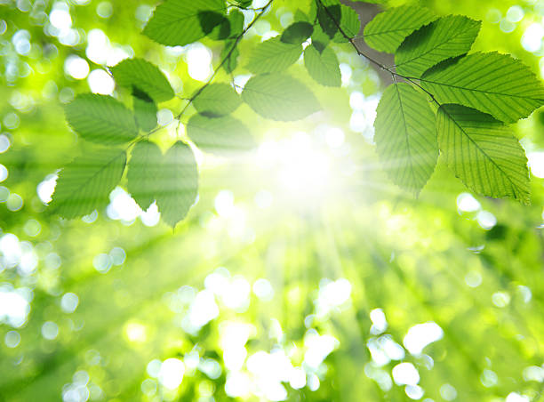
Leaves

Slide 24
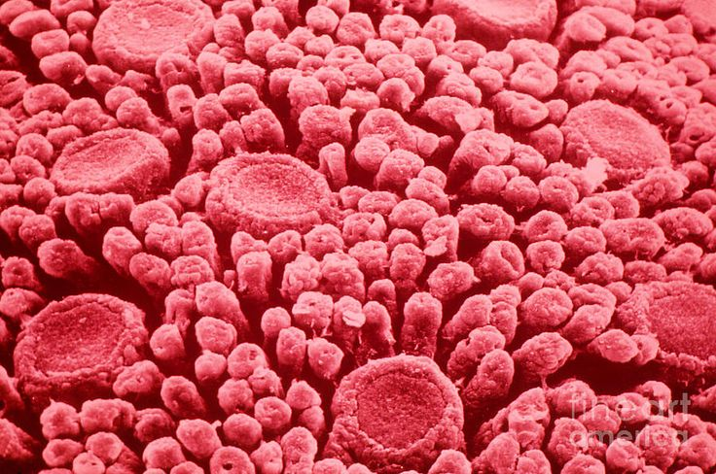
Taste Buds/
tongue

